Slide 1

Towards disentangling correspondence and emergence: The case of conscientiousness
Giulio Costantini, Luca Pancani, Marco Perugini
giulio.costantini@unimib.it
06/09/2018

Slide 2
Correspondence Emergence/network
Realist interpretation of latent variables. Traits are unobservable individual dispositions, independent of their manifestations, biologically based and resistant to environmental influences.
John has many friends, loves people and goes to parties because he is extraverted.
(McCrae & Costa, 2008; McCrae & Sutin, 2018).
Traits emerge from web of causal interactions among cognitions, emotions, motivations, behaviors, and situations.
John goes to parties because he likes people. By going to parties he makes new friends
(Baumert et al., 2017; Costantini & Perugini, 2018; Cramer et al., 2012).
PART1: Intro – Step 1 – Step 2 – Step 3 – PART2: Study 1 – Study 2 – Study 3 – Study 4 - Conclusions

Slide 3
Correspondence
"Neither life experiences nor culture are supposed to affect traits "
(McCrae & Costa, 2008)
“Any psychological environment will lead, in the long run, to the same levels of personality traits.”
(McCrae & Sutin, 2018)
PART1: Intro – Step 1 – Step 2 – Step 3 – PART2: Study 1 – Study 2 – Study 3 – Study 4 - Conclusions

Slide 4

Correspondence, example
John is an unconscientious student.
Suppose an environmental condition X (a new teacher), through a mechanism M (the teacher is able to motivate John), is connected to relevant manifestations of the trait (John studies more).
This is not going to affect John’s conscientiousness, besides that specific manifestation. In the long term, John does not become more organized, industrious, responsible, or controlled.
PART1: Intro – Step 1 – Step 2 – Step 3 – PART2: Study 1 – Study 2 – Study 3 – Study 4 - Conclusions

Slide 5
Emergence/network
“Personality dimensions emerge out of the connectivity structure that exists between their components"
(Cramer et al., 2012)
“[traits] are seen as emergent from interactions among the elements of the personality network over time".
(Baumert et al., 2017)
Changes in relevant environments, over time, can have an effect, through a complex web of causal relationships, on the trait itself.
John’s conscientiousness is
more likely to change.
5
PART1: Intro – Step 1 – Step 2 – Step 3 – PART2: Study 1 – Study 2 – Study 3 – Study 4 - Conclusions

Slide 6
It’s an empirical question… that can be tackled via experimental research
Experimental manipulation = controlled environments. If, by relying on our knowledge of a trait’s network, we are able develop a reliable method for experimentally manipulating a personality trait in the long term, this would strongly corroborate the emergence idea.
Conversely, if we are systematically unable to do so, this would corroborate a view based on correspondence. (Costantini & Perugini, 2018)
A recent meta-analysis has shown that experimental manipulations (whose aim was not changing traits) can have «collateral» but long-lasting effects on traits (Roberts et al., 2017)
Individuals willing to change their personality seem able to do so and seem to benefit from implementation intentions (Hudson & Fraley, 2015)
PART1: Intro – Step 1 – Step 2 – Step 3 – PART2: Study 1 – Study 2 – Study 3 – Study 4 - Conclusions

Slide 7
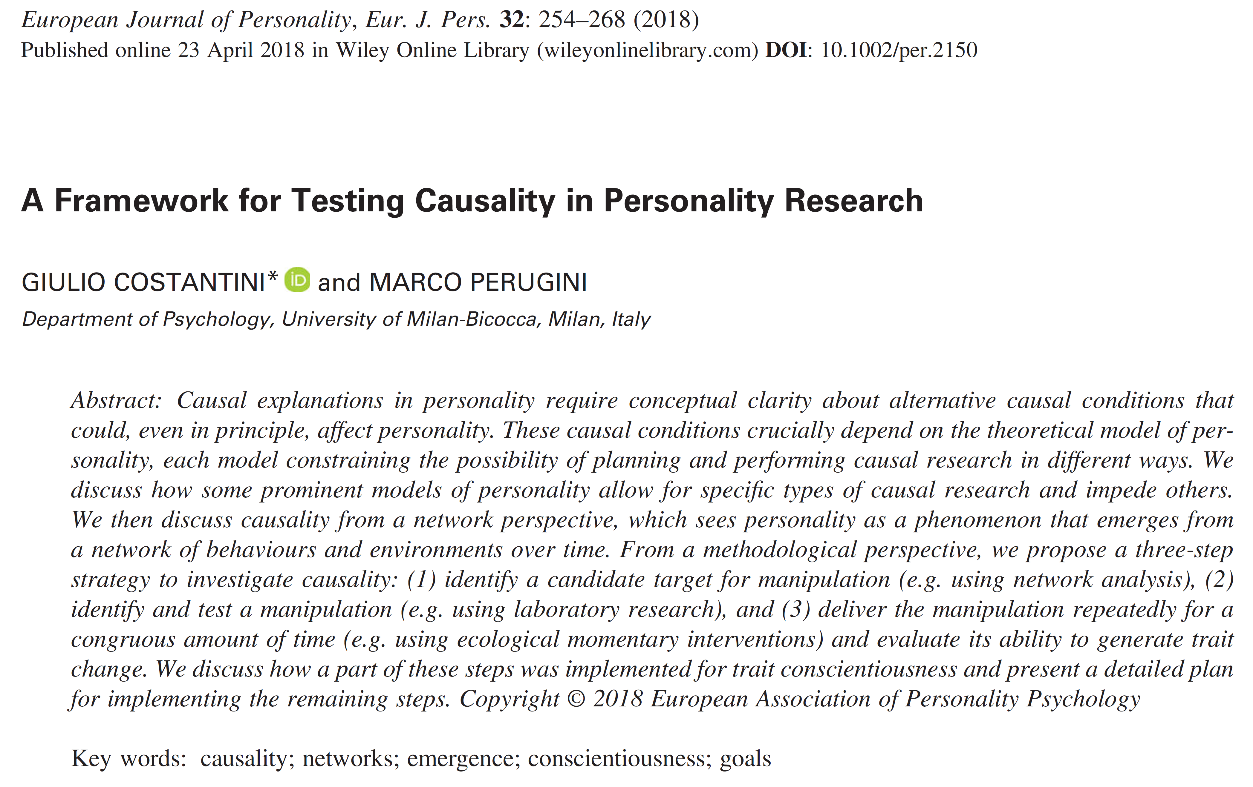

Step 1. Identify target
Step 2. In lab manipulation of target
Step 3. Ecological Momentary Intervention
A three-step framework, a long road. Each step requires several studies. Each step can go wrong.
(We are now in the middle of Step 2)

Slide 8
Step 1. Identify a target
Identify target constructs for experimental intervention, using non-experimental research.
The ideal targets:
Are well connected with several aspects of the trait.
Can be manipulated.
Can be assessed not only with self-reports, but also via behavioral indicators.
Networks/GGM are a good way to identify candidates: Disconnected nodes are less likely to be directly causally related (Epskamp et al., 2018; see Sacha’s talk). But networks do not imply causality.
PART1: Intro – Step 1 – Step 2 – Step 3 – PART2: Study 1 – Study 2 – Study 3 – Study 4 - Conclusions

Slide 9
PART1: Intro – Step 1 – Step 2 – Step 3 – PART2: Study 1 – Study 2 – Study 3 – Study 4 - Conclusions

Slide 10
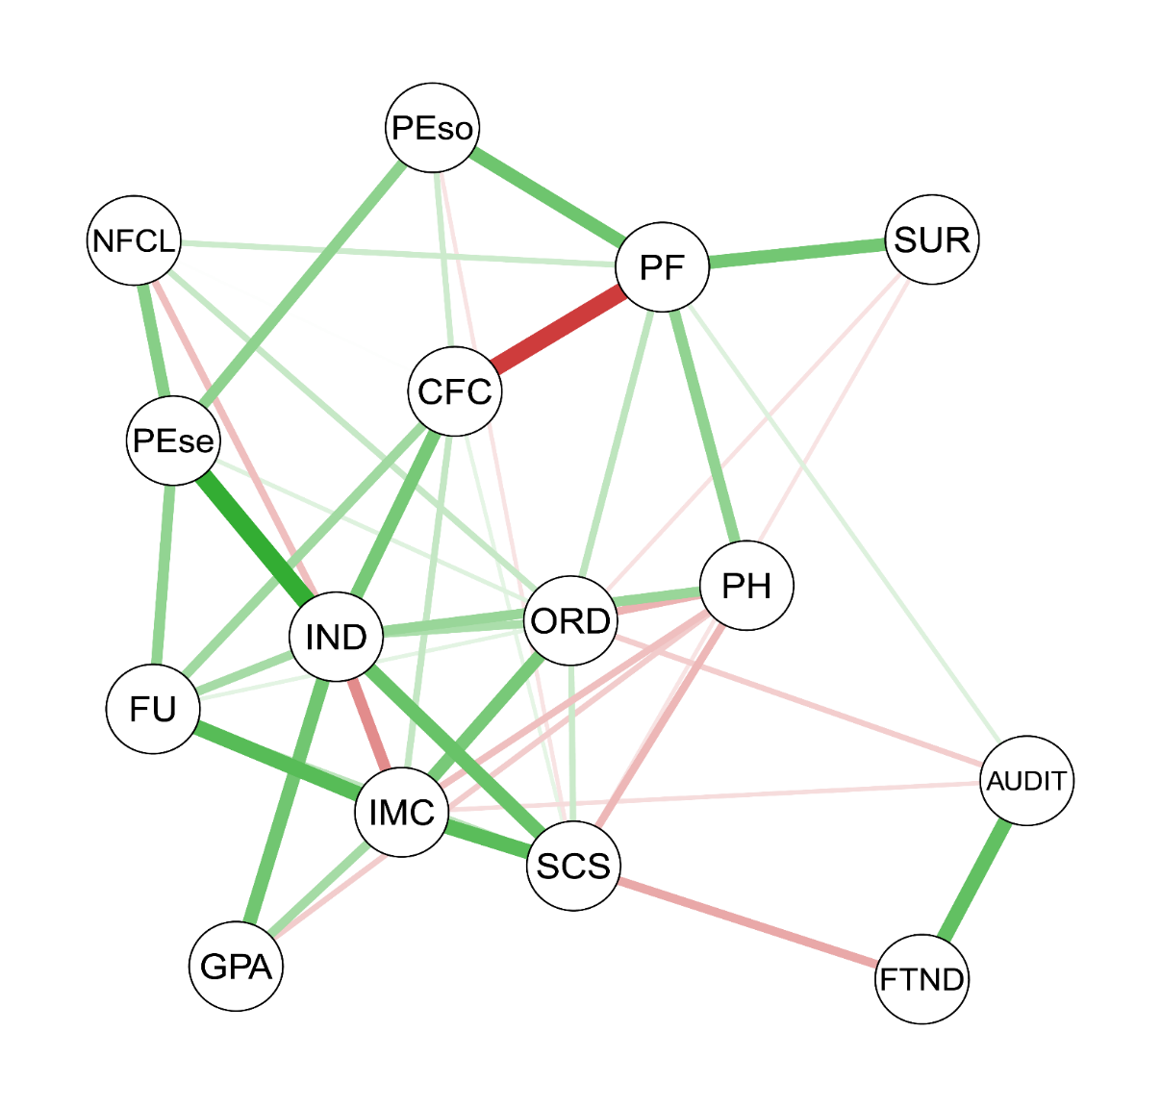
Step 1. Self-control and future orientation (Costantini & Perugini, 2016)
Self-control and Future orientation/Consideration of future consequences are connected to all main conscientiousness facets. If partialled out, correlations among conscientiousness facets wane (see also Costantini et al., 2015).
Good candidates for manipulation in experimental studies
PART1: Intro – Step 1 – Step 2 – Step 3 – PART2: Study 1 – Study 2 – Study 3 – Study 4 - Conclusions

Slide 11
Step 2. Development of a procedure to affect the target construct
Identify candidate experimental manipulations (i.e., a controlled environment).
Evaluate their short-term effect on the target (e.g., self-control). Pre-post manipulation change can be evaluated both on behavioral indices (e.g., delay of gratification tasks) and on self-concept.
Recent studies suggest that repeated practice (e.g., 4-8 weeks) is more likely to produce stable change
(Robert et al, 2017; Lally et al., 2010; Wrzus & Roberts, 2017)
PART1: Intro – Step 1 – Step 2 – Step 3 – PART2: Study 1 – Study 2 – Study 3 – Study 4 - Conclusions

Slide 12
Step 2. Candidate manipulations (1)
Need to be quick and portable (see Step 3)
Manipulations developed in ego-depletion framework (e.g., handgrip squeezing task) did not receive support recently.
(Beames et al., 2018; Friese et al., 2016; Lee & Kemmelmeier, 2017).
Self-control/future orientation are connected to goals (e.g., a stimulus becomes a temptation only if it conflicts with a goal). They consist in advancing abstract and distal goals over concrete and proximal motives.
(e.g., Fujita, 2011; Milyavskaya et al., 2015)
According to recent studies, SC often happens effortlessly (e.g., less experience of temptations and less-frequent impulse inhibition).
(Hofmann et al., 2012; Imhoff et al., 2014; Milyavskaya & Inzlicht, 2017)
SC might indicate a better integration of long-term goals within one’s goals system.
PART1: Intro – Step 1 – Step 2 – Step 3 – PART2: Study 1 – Study 2 – Study 3 – Study 4 - Conclusions

Slide 13
Step 2. Candidate manipulations (2)
Why manipulation / construal-level. Think of a goal and generate superordinate ends for that goal by answering why-questions. Promote insight on goals and motives
(Freitas et al., 2004; Fujita, 2006, 2011).
Mental contrasting. Individuals reflect both on positive future outcomes connected to goal pursuit and on potential obstacles. Promotes insight also on obstacles
(Oettingen, 2012)
Implementation intentions: form if-then plans, thus linking goal-pursuit to specific situational triggers. Can promote formation of habits.
(Gollwitzer, 1999; Hudson & Fraley, 2015).
Control group: Same procedures on an irrelevant target.
PART1: Intro – Step 1 – Step 2 – Step 3 – PART2: Study 1 – Study 2 – Study 3 – Study 4 - Conclusions

Slide 14
Step 3. Ecological momentary interventions (EMI, Heron & Smyth, 2010)
We plan to deliver the same manipulations repeatedly (e.g., via smartphone) for a longer time 4-8 weeks (with variation in goals).
We will inspect whether the manipulation can result in long lasting changes in the whole trait by assessing the trait before/after the manipulation and at subsequent follow-ups (e.g., for 1 year), but not during the manipulation, to avoid reactivity effects (French & Stutton, 2010)
These procedures will be administered only to individuals willing to change the trait (e.g., Robinson et al., 2015)
PART1: Intro – Step 1 – Step 2 – Step 3 – PART2: Study 1 – Study 2 – Study 3 – Study 4 - Conclusions

Slide 15
Manipulating conscientiousness requires knowledge of its motivational bases
All manipulations we considered rely on goals
An idea further supported by results showing that WS variation in conscientiousness is explained by WS variation in goals. Conscientious behavior inceases if individuals are assigned a conscientiousness-related goal (McCabe & Fleeson, 2016).
Several other studies showed connections between goals and traits. Most studies focused either on very broad goals (e.g., Lüdtke et al., 2009; Reisz et al., 2013; Roberts & Robins, 2000) and general motivational tendencies (McCabe, et al., 2013; Sorić, et al. 2017) or on a very specific subset of goals (McCabe & Fleeson, 2016).
In the following, we report a set of studies aimed at identifying the main goals associated to conscientious behavior, using a bottom-up approach
PART1: Intro – Step 1 – Step 2 – Step 3 – PART2: Study 1 – Study 2 – Study 3 – Study 4 - Conclusions

Slide 16
Conscientious goals
(Step 2)

Slide 17
Study 1. Initial identification of goals
(Costantini & Perugini, 2018)
N = 40 participants indicated goals for 44 conscientiousness adjectives, and superordinate goals for each goal, iteratively.
Step 1. “Why do your or would you behave in an <industrious> way?” (lazy, organized….)
(e.g., Because I want to graduate)
Step 2. Why is this or could this be important for you?
(e.g., Because I want to be successful)
Two independent raters classified 3520 responses in goals/non-goals (K = .83) and classified goals in 26 classes (K = .81).
Some classes were mainly elicited by conscientious adjectives (e.g., Personal realization), some by unconscientious adjectives (e.g., Avoid managing things you don’t care), some by both (e.g., Avoid repentance or remorse).
PART1: Intro – Step 1 – Step 2 – Step 3 – PART2: Study 1 – Study 2 – Study 3 – Study 4 - Conclusions

Slide 18
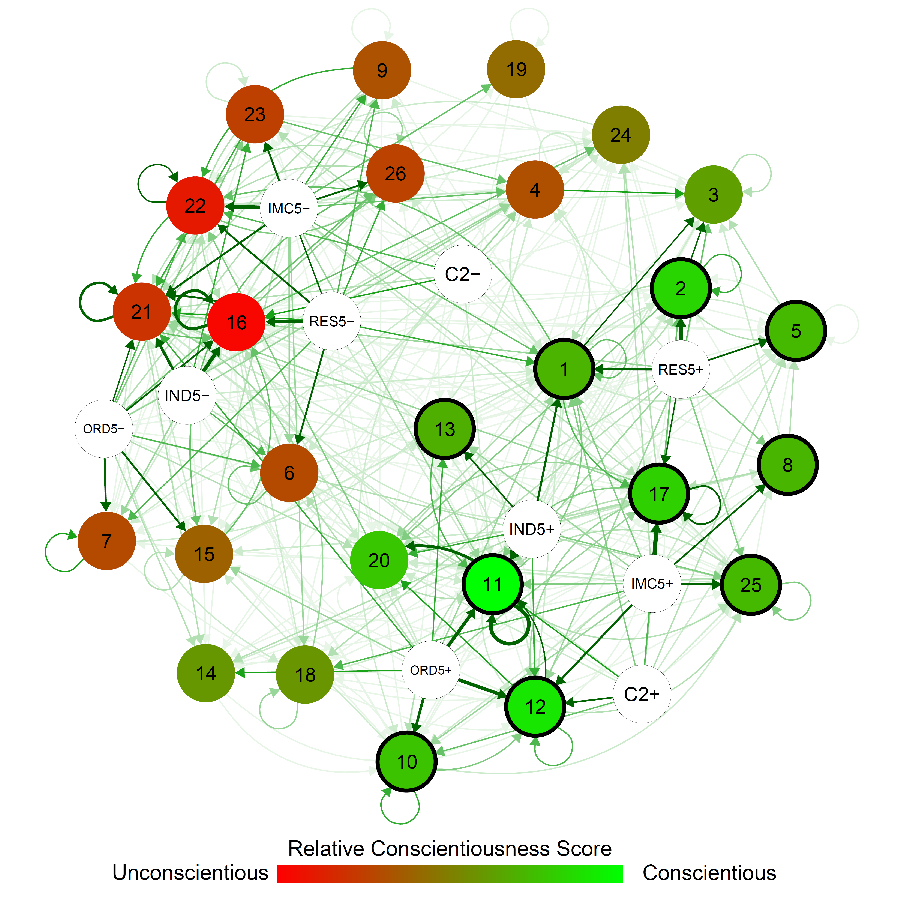
Results
We built a network linking conscientiousness facet poles (white circles) to goals (Bagozzi et al., 2003).
We defined the Relative Conscientiousness Score (RCS) to identify goals related to each pole, standardized residuals in a chi-square test for independence between goals and conscientiousness poles.
We identified 11 conscientious goal classes and 10 unconscientious goal classes according to RCS
PART1: Intro – Step 1 – Step 2 – Step 3 – PART2: Study 1 – Study 2 – Study 3 – Study 4 - Conclusions

Slide 19
Goal Classes
Conscientious goals | Unconscientious goals
Personal realization (RCS = 11.94) | Avoid managing things you don’t care (RCS = -13.46)
Do something well, avoid mistakes (RCS = 9.62) | Try new sensations (RCS = -11.47)
Be trustworthy (RCS = 7.66) | Feel good (RCS = -8.86)
Safety (RCS = 7.24) | Manifest or vent a negative emotion (RCS = -7.49)
Personal satisfaction (RCS = 6.02) | Avoid thinking (RCS = -7.25)
Have control (RCS = 5.94) | Hide something from someone (RCS = -6.58)
Do good to someone, avoid hurting (RCS = 4.82) | Hurt someone (RCS = -6.47)
Think, reflect (RCS = 4.79) | Rebel, transgress rules (RCS = -5.67)
Comply with rules (RCS = 4.56) | Manipulate other’s behavior (RCS = -5.99)
Demonstrate something to others (RCS = 4.35) | Save time (RCS = -4.22)
Accomplish something (RCS = 3.70)
PART1: Intro – Step 1 – Step 2 – Step 3 – PART2: Study 1 – Study 2 – Study 3 – Study 4 - Conclusions

Slide 20
Limitations
Small sample size (N = 40).
Open-ended response format
Subjective judgment in scoring.
Equifinality: Some goals could be also connected to traits other than Conscientiousness (Kruglanski, 2002).
PART1: Intro – Step 1 – Step 2 – Step 3 – PART2: Study 1 – Study 2 – Study 3 – Study 4 - Conclusions

Slide 21
Study 2.
AIMS:
Validating the RCS method: Can it discriminate conscientious / unconscientious goals?
Identifying equifinality relationships with other traits
Method:
N = 299 students were given 12 descriptions of the positive/negative poles of HEXACO traits (Lee & Ashton, 2008). They indicated how much an individual who matched the description may pursue each of 21 goals, on a 7-point scale (1 = not at all, 7 = very much).
Planned missing data design: All rated conscientious/unconscientious profiles plus another trait (N ~ 60).
(Graham et al., 2006; Little & Rhemtulla, 2013)
Power ~ .99 for d = .5
PART1: Intro – Step 1 – Step 2 – Step 3 – PART2: Study 1 – Study 2 – Study 3 – Study 4 - Conclusions

Slide 22
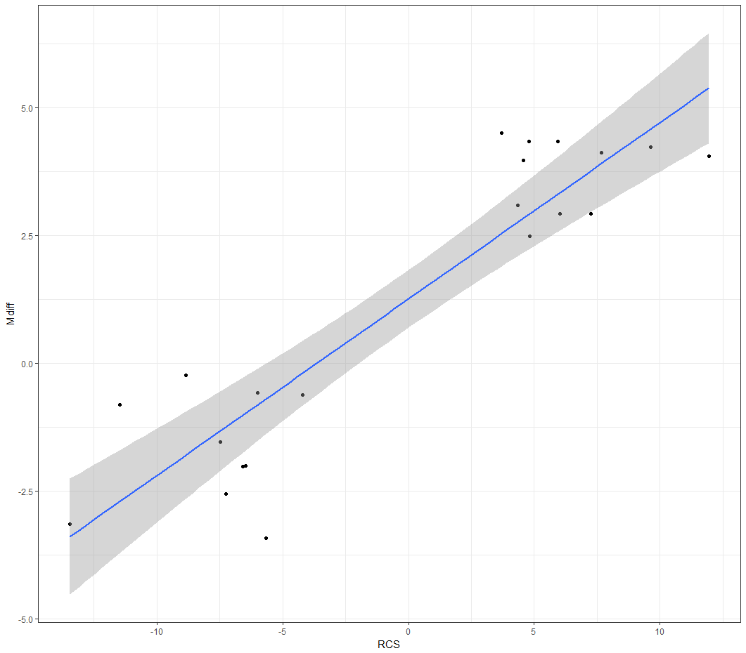
Results 1 – validating RCS
21 one-tailed t-test to inspect whether each goal was associated to the corresponding conscientiousness pole, according to RCS.
The results replicated quite well, with a correlation between RCS and the Mean difference in rating, r = .91.
Generally larger effect for conscientious (vs. unconscientious) goals. Only one («feel good») resulted in a nonsignificant result, t(298) = 1.54, p = .062, all other ps < .001
PART1: Intro – Step 1 – Step 2 – Step 3 – PART2: Study 1 – Study 2 – Study 3 – Study 4 - Conclusions

Slide 23
Results 2 - equifinality
We performed 10 partially-overlapping-samples one-sided t-test (Derrick, Russ, Toher, & White, 2017) for each goal class, to compare the score on Conscientiousness with the score on other poles of each trait.
7 out of 11 conscientious goal classes were significantly more associated to conscientiousness than to any of the 10 poles of other traits.
PART1: Intro – Step 1 – Step 2 – Step 3 – PART2: Study 1 – Study 2 – Study 3 – Study 4 - Conclusions

Slide 24
Worst result for each class
Conscientious goals | M | SD |  | M | SD | t | df | p
Personal realization | 6.30 | 1.06 | O+ | 5.98 | 0.97 | 2.28 | 79.46 | .012
Do something well, avoid mistakes | 6.21 | 0.96 | A- | 3.58 | 1.57 | 12.45 | 63.95 | <.001
Be trustworthy | 6.05 | 1.04 | H+ | 6.00 | 1.06 | 0.35 | 69.57 | .360
Safety | 5.61 | 1.19 | E+ | 5.05 | 1.93 | 2.2 | 68.63 | .016
Personal satisfaction | 5.75 | 1.34 | E- | 5.75 | 1.19 | 0 | 85.57 | .500
Have control | 6.23 | 1.09 | A- | 3.68 | 2.05 | 9.34 | 62.48 | <.001
Do good to someone, avoid hurting | 5.39 | 1.30 | X+ | 5.33 | 1.41 | 0.34 | 74.71 | .368
Think, reflect | 6.27 | 1.06 | A- | 3.37 | 1.73 | 12.39 | 63.89 | <.001
Comply with rules | 6.11 | 1.08 | H+ | 5.79 | 1.26 | 1.84 | 65.79 | .035
Demonstrate something to others | 5.44 | 1.43 | H- | 5.57 | 1.78 | 0.5 | 64.53 | .308
Accomplish something | 6.57 | 0.83 | A- | 3.97 | 1.29 | 15.34 | 64.67 | <.001
PART1: Intro – Step 1 – Step 2 – Step 3 – PART2: Study 1 – Study 2 – Study 3 – Study 4 - Conclusions

Slide 25
Study 3
Does Conscientiousness predict the self-rated importance of each goal class?
N = 330 participants self-rated the importance of each goal class and filled in the HEXACO-60 (Ashton & Lee, 2009) and the BFI2 (Soto & John, 2017).
Multiple regressions to check wether each goal’s importance was uniquely predicted by conscientiousness, after controlling for other traits
PART1: Intro – Step 1 – Step 2 – Step 3 – PART2: Study 1 – Study 2 – Study 3 – Study 4 - Conclusions

Slide 26
Conscientious Goals ~ HEXACO
Results are close to those of Study 2
Conscientious goals | C | H | E | X | A | O | R²
Personal realization | 0.16*** | -0.17*** | 0.01 | -0.04 | -0.10 | 0.08 | 0.07***
Do something well, avoid mistakes | 0.39*** | -0.09 | 0.03 | 0.00 | 0.03 | 0.07 | 0.15***
Be trustworthy | 0.11 | -0.04 | 0.06 | 0.09 | 0.02 | 0.07 | 0.03
Safety | 0.18*** | -0.02 | 0.32*** | -0.03 | 0.16*** | -0.07 | 0.16***
Personal satisfaction | 0.06 | -0.10 | 0.01 | 0.16* | 0.02 | 0.12* | 0.05**
Have control | 0.30*** | -0.12* | 0.05 | -0.10 | 0.00 | -0.09 | 0.12***
Do good to someone, avoid hurting | 0.04 | 0.27*** | 0.23*** | 0.08 | 0.17*** | 0.14*** | 0.24***
Think, reflect | 0.19*** | 0.01 | -0.04 | -0.08 | 0.02 | 0.03 | 0.04*
Comply with rules | 0.26*** | 0.10 | 0.09 | -0.09 | 0.20*** | -0.08 | 0.15***
Demonstrate something to others | 0.08 | -0.15* | 0.12* | -0.06 | 0.11 | 0.01 | 0.04*
Accomplish something | 0.22*** | 0.02 | 0.10 | 0.03 | 0.02 | 0.09 | 0.07***
PART1: Intro – Step 1 – Step 2 – Step 3 – PART2: Study 1 – Study 2 – Study 3 – Study 4 - Conclusions

Slide 27
Study 4
Aims:
Generating a large set of conscientious goals
Inspecting connections between goals, conscientiousness and its facets
We generated 56 goals, 8 for each class.
N = 221 participants rated the extent to which each goal was important to them.
We also assessed three main conscientiousness facets, INDustriousness, ORDerliness, and IMpulse Control (mirroring Costantini & Perugini, 2016) as well as the HEXACO traits (Ashton & Lee, 2009).
PART1: Intro – Step 1 – Step 2 – Step 3 – PART2: Study 1 – Study 2 – Study 3 – Study 4 - Conclusions

Slide 28
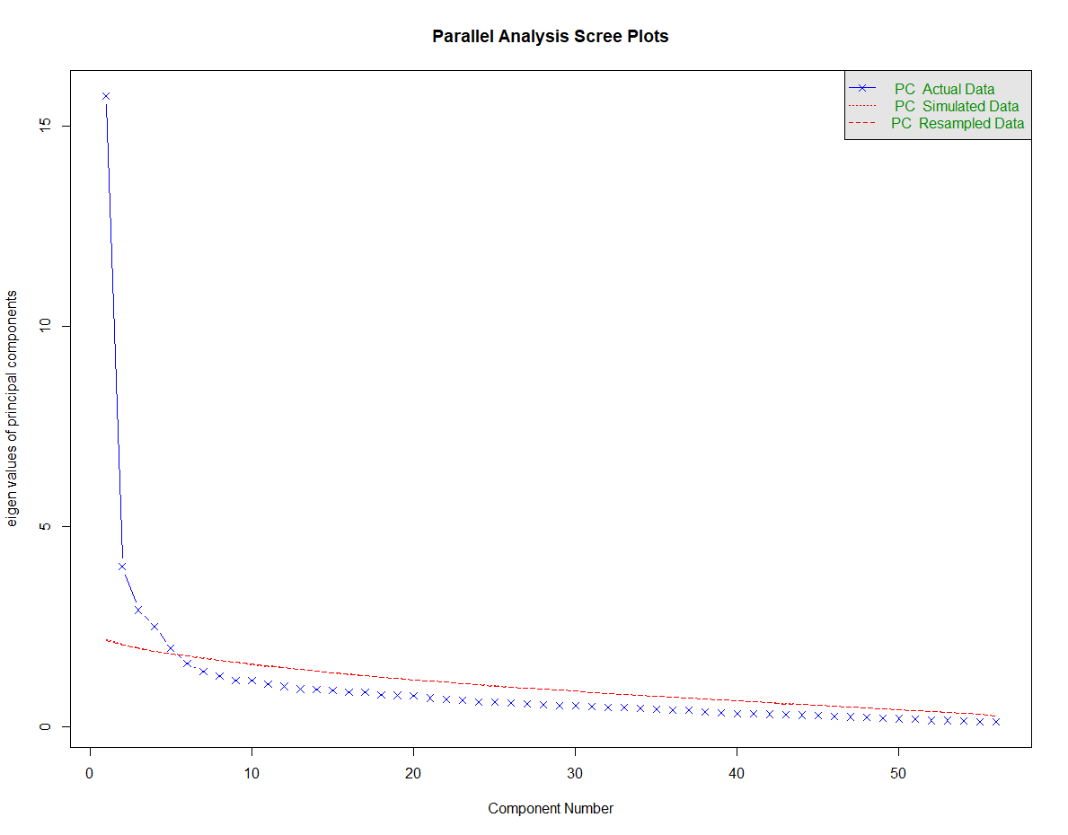
Results
In the one-factor solution, loadings ranged from .22 to .69 (M = .52).
Parallel analysis suggested a five-factor structure.
PART1: Intro – Step 1 – Step 2 – Step 3 – PART2: Study 1 – Study 2 – Study 3 – Study 4 - Conclusions

Slide 29
 | Personal Realization | Have control / Avoid mistakes | Comply with rules | Safety | Accomplish something
Achieve good results | .79
Be successful | .69 |  |  |  | -.21
Get the most | .67 | .24
Achieve results at school, academia or work | .63
Do what I do at best | .63
Overcome myself | .58
Do an excellent job | .57
Realize myself | .51 |  |  | .36
Do everything in the best possible way | .42 |  |  |  | .3
Keep everything under control |  | .77
Have full control |  | .77
Have everything in control |  | .71
Do not make mistakes | .22 | .56 | .22
Control a situation |  | .55
Don't miss any detail |  | .49
Avoid making mistakes |  | .49
Don't mess up |  | .47 |  |  | .27
Avoid chaos | -.22 | .44 | .31
Avoid oversights |  | .43 | .20
Evaluate all options before making a decision |  | .41 |  |  | .30
Not leaving anything to chance |  | .36 | .24
Follow the rules |  |  | .74
Follow the law |  |  | .70
Act according to the rules |  |  | .66
Avoid breaking rules |  |  | .64 | .26
Respect an authority |  |  | .56 |  | .28
Do everything within the time planned | .26 |  | .55 | -.27 | .24
Do not break the mold | -.34 | .40 | .44
Avoid Risks |  | .32 | .43 | .29
PART1: Intro – Step 1 – Step 2 – Step 3 – PART2: Study 1 – Study 2 – Study 3 – Study 4 - Conclusions

Slide 30
 | Personal Realization | Have control / Avoid mistakes | Comply with rules | Safety | Accomplish something
Protect myself |  |  |  | .74
Avoid hurting myself |  |  |  | .68
Safeguard myself |  |  |  | .62
Be healthy | .23 |  |  | .60
Stay safe |  |  |  | .55
Don't put myself in danger |  | .20 | .42 | .53
Don't get in trouble |  | .20 | .36 | .53
Have financial security | .22 |  |  | .51
Have a future | .36 | -.22 |  | .51
Fulfill a committment |  | -.20 | .20 |  | .69
Find my stuff |  | .20 |  | .25 | .53
Order my thoughts |  | .32 | -.20 |  | .51
Respect the context I am in |  |  | .28 |  | .50
Find things when I need them |  |  |  |  | .50
Finish a job in time | .27 |  | .32 |  | .50
Keep committments |  |  |  |  | .47
Finish something | .41 |  |  |  | .47
Accomplish a project | .33 |  | .20 |  | .44
Analyze situations well |  | .37 |  | .24 | .42
Avoid abandoning things unaccomplished |  |  | .28 |  | .39
Foresee the consequences of my actions |  | .31 |  |  | .39
Do things well | .33 |  | .28 |  | .22
Take good decisions | .29 | .22 |  | .27
Avoid interrupting work |  |  | .33 |  | .30
Behave according to my values | .22 |  | -.30 | .25 | .24
Take the right decision | .24 |  |  | .31 | .24
Find the best solution when I have a problem | .31 |  | -.24 | .3 | .31
PART1: Intro – Step 1 – Step 2 – Step 3 – PART2: Study 1 – Study 2 – Study 3 – Study 4 - Conclusions

Slide 31
Multiple regressions predicting each goals form HEXACO traits
Conscientious goals | C | H | E | X | A | O | R²
Personal Realization | .34*** | -.19* | .12 | .09 | -.05 | .09 | .18***
Have control / Avoid mistakes | .30*** | -.21*** | .15* | .05 | -.02 | .06 | .15***
Comply with rules | .30*** | .16* | .24*** | .02 | .21*** | -.21*** | .30***
Safety | .04 | .02 | .34*** | .12 | -.04 | -.09 | .14***
Accomplish something | .23*** | .05 | .23*** | .13 | .02 | -.03 | .16***
All goal factors are uniquely connected to conscientiousness, except Safety, which was mainly connected to Emotionality.
PART1: Intro – Step 1 – Step 2 – Step 3 – PART2: Study 1 – Study 2 – Study 3 – Study 4 - Conclusions

Slide 32
Facet level
Goal | ORD | IND | IMC | H | E | X | A | O | R2
Personal Realization | -.10 | .65*** | -.11 | -.14* | .17* | -.04 | -.01 | .01 | .33***
Have control / Avoid mistakes | .31*** | .13 | -.07 | -.19*** | .15* | .01 | .02 | .07 | .20***
Comply with rules | .07 | .07 | .28*** | .16* | .21*** | .03 | .17* | -.21*** | .33***
Safety | -.01 | .03 | -.02 | .02 | .35*** | .12 | -.03 | -.09 | .14***
Accomplish something | -.02 | .33*** | -.06 | .08 | .26*** | .07 | .05 | -.07 | .18***
Each goal class is also specifically connected to one conscientiousness facet.
Having available a broad set of goals connected to each facet would allow to develop manipulations connected to several aspects of the trait, instead of very specific behaviors.
PART1: Intro – Step 1 – Step 2 – Step 3 – PART2: Study 1 – Study 2 – Study 3 – Study 4 - Conclusions

Slide 33
Conclusions / Future directions (1)
Using bottom-up approach, we identified a comprehensive set of goals connected to all aspects of conscientiousness, which was crucial to fully implement Step2.
The correspondence and emergence perspective differ on a crucial prediction, the effects of environments on traits. We have delineated a three-step framework for testing whether traits can be causally affected by manipulations (i.e., controlled environments).
Step 1 (done). Using network analysis, we have identified self-control and future-orientation as candidate targets for manipulation.
Step 2 (ongoing). We have identified a set of candidate manipulations of self-control, which required knowledge of the motivational bases of conscientiousness.
Ongoing data collections on in-lab experimental studies (not yet complete!)
Step 3 (planned). We will attempt to produce reliable trait change, by for repeatedly administering the manipultions identified in Step 2 using Ecological Momentary Interventions.
PART1: Intro – Step 1 – Step 2 – Step 3 – PART2: Study 1 – Study 2 – Study 3 – Study 4 - Conclusions

Slide 34
Conclusions / Future directions (2)
A reilable and successful manipultion of a trait is going to support an emergence view against the correspondence assumption. However, correspondence and emergence can co-exist within the same trait
(Mottus & Allerhand, 2018)
We are now in the middle of Step 2: Feedback on our results and on our plans are more than welcome!
PART1: Intro – Step 1 – Step 2 – Step 3 – PART2: Study 1 – Study 2 – Study 3 – Study 4 - Conclusions

Slide 35
Thank you for your attention!

